Slide 1
Writing your own R packages
how, why, and what's in it for me?

Slide 2
Why packages?
You have a great idea and others can benefit from it
You have code that should be shared with and used by coworkers or collaborators
Can help you organize your code for longer projects
Can help you document code that you may use intermittently

Slide 3

Soap box
If you do something cool, for the love of all that is holy, share it!

Slide 4
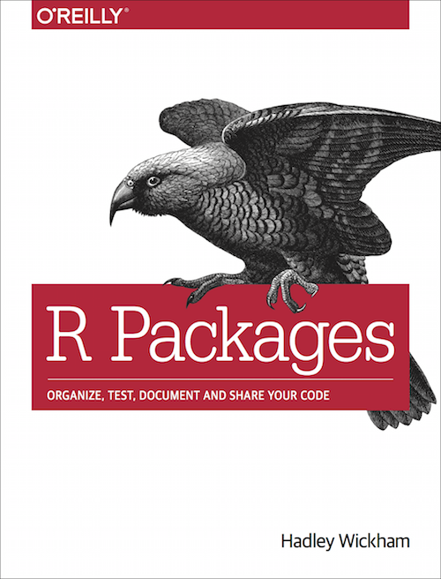
Essential resource
Book is available online for free at
http://r-pkgs.had.co.nz/
Hadley Wickham updates the online book regularly
Following the procedures in this book will help you construct a package that can be submitted to CRAN

Slide 5
Packages needed
Rtools
devtools
roxygen2
testthat
Most recent versions of R and R Studio

Slide 6
Basic structure
R – folder contains all of your R Code
DESCRIPTION - defines metadata for the package
man folder - roxygen2 produces help pages that explain how to use the package
Information added to R code and help pages generated by roxygen2
NAMESPACE – defines which functions are needed by other packages and what functions it makes available to other packages
Automatically generated by roxygen2
README – Records updates and other helpful information about version changes and other basic information about the package
Should be updated every time the package is updated

Slide 7

How to start
Choose a name
Can only contain letters, numbers, and periods
Cannot end with a period
Make it unique and applicable to what your package does
Recommended: use all lowercase letters
Update R and R Studio
Two choices
Select the following in R Studio from the drop down menus
New project > New directory > R package
Enter in the name of your package
Tell R Studio the directory path of where your package code should be
Check boxes for uploading to Github and/or using packrat if desired
devtools::create("path/to/package/pkgname")
Now you have a skeletal version of an R package

Slide 8

\R directory
CREATE
All of your R code goes here
Most of the work for the package happens in these files
Thoughtfully organize your functions into files
Simple package: one function per file
Complex package: several functions per file
If you have a hard time finding your functions
Use better names for files and functions
Consider changing file configuration

Slide 9
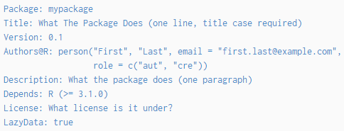



DESCRIPTION
Edit the DESCRIPTION file that magically appears in your package
Contains metadata for the package
Include:
Title
Author(s)
Description
Required packages
Recommended packages
License - most packages use GPL-3

Slide 10

\man folder
DO NOT EDIT THE FILES IN THIS FOLDER!
Contains .Rd files that create the help files
roxygen2 automatically creates .Rd files from information included in the .R files
Create .Rd files using the following commands
devtools::load_all()
devtools::document()

Slide 11
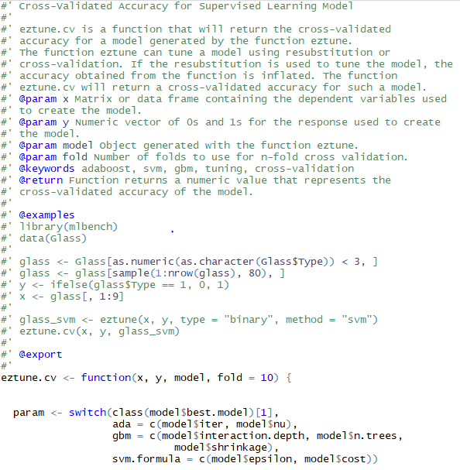
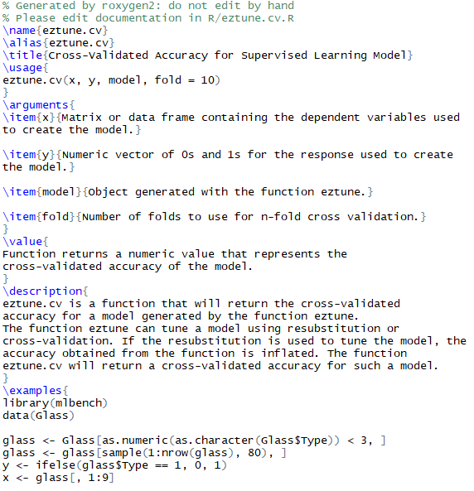
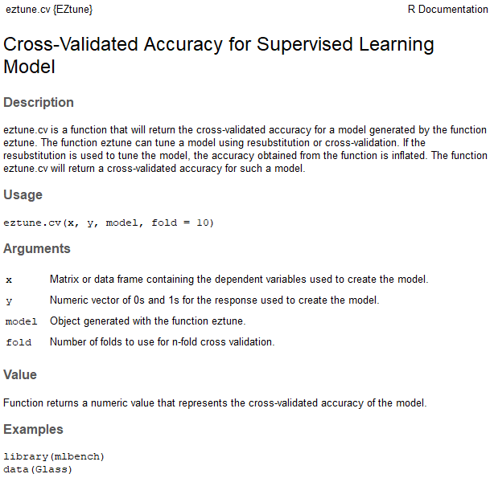
\man folder
.R file .Rd file Help page

Slide 12

NAMESPACE
DO NOT EDIT!
Created automatically by roxygen2 using information .R files
Contains imports and exports
NAMESPACE files can get very complex and they are difficult to understand.
Roxygen2 will give you what you need
Eventually, you may want to edit your file

Slide 13
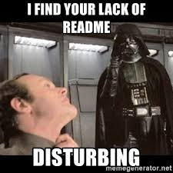
README.md
You need to create and update this
Should be updated every time you update the package
Includes
Information about past versions
Changes made to current version
Notes that are helpful for you
Notes that are helpful for others
Everything will work fine without a README file, but it’s bad form to not have one and maintain it

Slide 14
Other features
Data (data/)
You can include data files as part of your package
Other compiled code (src/)
You may use C or C++ to execute tasks in your package
Can use Rcpp
Can import and export C or C++ code
Vignette (vignettes/)
If you write a really nice vignette you should publish it

Slide 15
Other features
Installed files (inst/)
Author
Citation
Additional external data
Java, python, perl, ruby, etc. code
Other components
Package demos (demo/)
Executable scripts (exec/)
Translation messages (po/)
Auxillary files needed during configuration (tools/)

Slide 16
Coding your package
How do your write the R files?
Create .R files and save them to R/
Each exported functions (the ones package users will use) in their own files
This is not necessary, but it is much cleaner
Keep hidden functions in separate files from exported functions
Use roxygen2 comments in the exported functions to produce documentation
Remember to include examples
Test code often using devtools::load_all() and then using your package as intended
Run devtools::document() to create help files
Test help files using ?package_function

Slide 17
Best practices
ALWAYS use the package::function() notation when coding
NEVER have your package install other packages
This should be taken care of in the DESCRIPTION file
ALWAYS create and maintain a README.md file, even if you are the only one using the package
FREQUENTLY reassess your file structure and reorganize your functions if the current configuration no longer makes sense
Write good examples
Write helpful error and warning messages
Provide thorough documentation even if you are the only one using the package
Comment all code
Make good help files

Slide 18
More best practices
Use google style guide for R coding
Write all packages as if you are going to publish them
Github is your friend
Sharing your code with other is a great way to find and fix bugs
Share development versions
TIP: NAMESPACE can be tricky if you are having trouble with it
Delete the NAMESPACE file and run devtools::document()
Make sure R and R Studio have permission to write to your computer

Slide 19
Getting ready to make code public
Test your own code carefully before publishing it on Github or CRAN
Run R CMD check on the code
devtools::check()
Test package on at least two operating systems
Windows
Linux or Unix
Mac OS
TIP: sometimes the devtools functions fail to run the first time. Try running them again before assuming there is something wrong

Slide 20
Github
You can upload a package to github even if you don’t initially tell R to do it
Great way to share code so others can use it and comment on it
devtools can be used to install packages directly from github
library(devtools)
install_github("author/package")
Example:
install_github("jillbo1000/EZtune")

Slide 21
Submitting to CRAN
Submitting to CRAN is a bit daunting, but worth it if you did something really useful and you want people to use it
CRAN is very picky
Using Hadley Wickham’s book will make the process as painless as possible
Run devtools::check() in two operating systems before submission
Get rid of all errors, warnings, and notes
First submission is automated
Plan on several submissions
Three guys have to check your code in their spare time without pay
Make sure you get your package as perfect as possible before each submission
They will get cranky if you don’t or if you submit revisions too often

